Slide 1
GEOSS Case Study
SE4950 System of Systems Engineering [and Integration] (SoSE&I)
System of Systems Engineering of GEOSS
Module 3, Case Study
April 17, 2013
Team 1
Lewis W. Berklich
Steve Mazza
Ralph Pinnock
Daniel Torres

Slide 2
Topics
GEOSS System of Systems
GEOSS Description and Background
Application of SoSE to GEOSS
SoSE Activities For GEOSS
System Characteristics and its Paradoxes

Slide 3
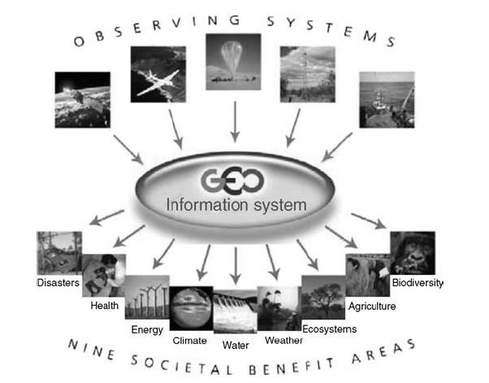
System of Systems
Source: Jamshidi, M. (2009). System of Systems Engineering: Innovations for the 21st Century

Slide 4
Description and Background

Slide 5
Application of SoSE to GEOSS

Slide 6
SoSE Activities for GEOSS
Visualize available resources
Incentivize and reduce cost
Promote coordination
Notes:
The broad, overarching activities for GEOSS are these. The SoS is very much a “coalition of the willing” and so many of the activities fall into “tracking” and “coordinating” lanes.

Slide 7
Visualize Available Resources
Map future prospects
Track user requirements
Manage systems, services, and language
Promote standards and interoperability
Establish best practices and quality assurance
Collect case studies and lessons learned
Notes:
Interoperability and standardization are key aspects, requiring a large proportion of attention. This often begins by simply identifying and agreeing on a common language. Keep in mind that “finding a common language refers not only to bridging the cultural and natural linguistic gaps of multi-national coalitions but also applies (maybe even more so) to synchronizing the data description, interfaces, and communication protocol that allow interoperable systems to work in concert.

Slide 8
Incentivize and Reduce Cost
Minimize barrier to contribution
Minimize barrier to integration
Seek stability
Encourage documentation
Embrace standardization
Avoid proprietary technology
Notes:
This activity hinges most on stability, standardization, and documentation. The hurdle is that GEOSS is comprised not only of newly emerging systems but also (and largely) legacy systems (e.g., weather buoys). Working within a loosely organized group defined by “inclusion through participation,” the overall costs to contribution must be managed. Costs are mostly measured in person hours spent integrating systems and data. This integration effort is significantly helped by embracing open standards. Working to maintain stability is also key as costs rise when working against a moving target.

Slide 9
Promote Coordination
Track goal achievement
Locate tasks within the data flow
Identify capability gaps
Notes:
The three pillars of coordination are to [read the above bullets], that is: knowing where tasks lie, which ones are yielding fruit, and identifying under-serviced areas.

Slide 10
System Characteristics / Paradoxes

Slide 11
Add

Slide 12
Open Discussion

